Slide 1
Rupesh Gelal
RNN slides

Slide 2
RNN was developed to overcome problems arising in sequence data. Output of RNN depends on current input as well as previous input.
h(t)
F
x(t)
Simple RNN

Slide 3
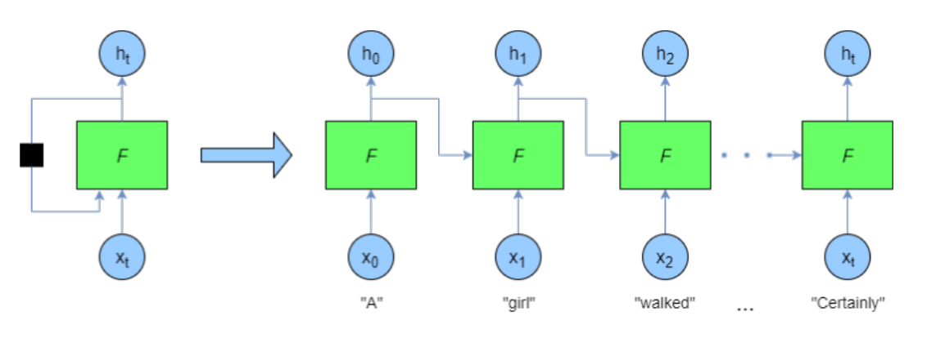
Recurrent Neural Network

Slide 4
Problem of RNN:
Vanishing gradient which ultimately affects the model performance.
Solution:
LSTM(Long Short Term Memory) and GRU(Gated Recurrent Unit)

Slide 5
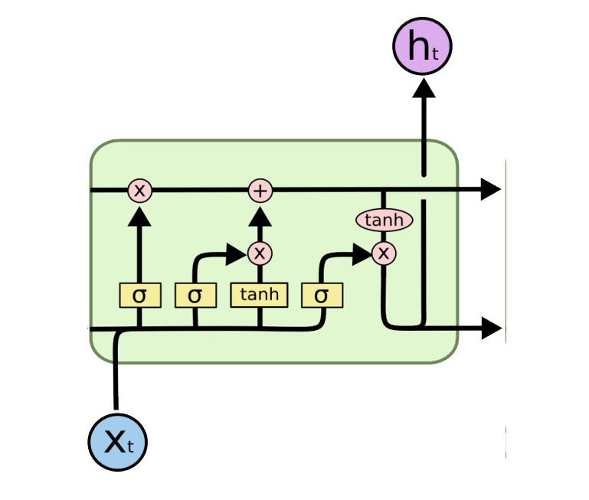
LSTM architecture
Three gates:
Input gate
Forget gate
Output gate

Slide 6
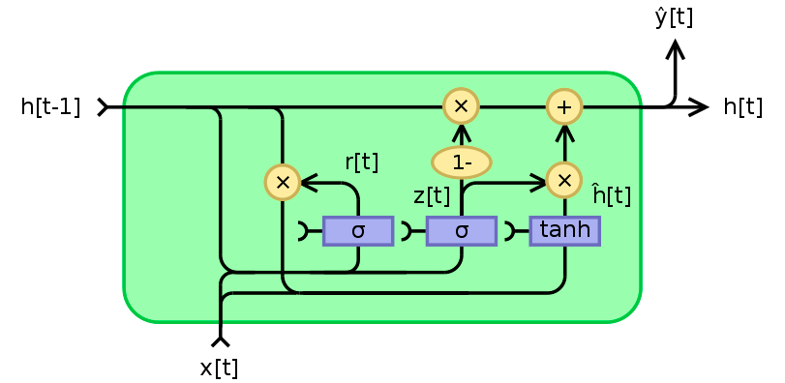
GRU architecture
Two gates:
Update gate
Reset gate

Slide 7
New architectures in the field:
1. Transformer(BERT and GPT)
2. XLNet
3. TransformerXL
4. ERNIE

